Slide 1

Prezoom Presentation
GROUP BRAVO – Shujana, Preethi, Utkarsh

Slide 2
Presentation Overview
Timeline
User Stories
Use Cases
Packages & Features
Reusability
Extensibility
Contribution
Future Work
Code Output
Overview Diagram

Slide 3
Timeline
Iteration 0 - Due November 2
Requirements document:
Domain model - UML class diagrams
Lexicon - Describes terminology
list of requirements, two sections:
Requirements for Iteration 1 (November 16th)
Requirements for Iteration 2 (November 30th)
Specification document:
Use case diagrams
State diagrams
Use cases
Wire frame diagrams
Sequence diagrams

Slide 4
Timeline
Iteration 1: (16th November 2020)
1. Container
2. Object and properties
3. States
4. Attributes
5. Features
Save
Load
Edit
6. Edit Mode
7. Transition
Improvements to the Diagrams
Improvements to Requirements and Specifications documents
Creating and Updating of Design document

Slide 5
Timeline
Iteration 2: (30th November 2020)
5. Features
Save
Load
Edit
6. Edit Mode
7. Transition
8. Undo Redo
9. Camera and Movement
10. Bug review
11. Testing
Improvements to the Diagrams
Improvements to Requirements and Specifications documents
Improvements to Design document

Slide 6
User Stories
T0 : The user requests the system to start the prezoom project by clicking the system’s run command.
T1 : The system will start a new window for java application.
T2 : The user can open a presentation from file menu
T3 : The user can create a new presentation from file menu
T4 : The user can save the presentation from file menu
T5 : The user can request the system to exit the prezoom project by clicking the system’s exit button.
T6 : The user can add states from home menu
T7 : The user can delete states from home menu
T8 : The user can create shapes (circle, rectangle, square, oval, line) from home menu
T9 : The user can delete shapes (circle, rectangle, square, oval, line) from home menu
T10 : The user can move shapes from home menu
T11 : The user can arrange shape by bringing front
T12 : The user can arrange shape by bringing forward
T13 : The user can arrange shape by sending back

Slide 7
User Stories
T14 : The user can arrange shape by sending backward
T15 : The user can change color of shapes from home menu
T16 : The user can create textbox for writing text from home menu
T17 : The user can choose Text Font from the text drop down menu.
T18 : The user can change the text size.
T19 : The user can undo from edit menu
T20 : The user can redo from edit menu
T21 : The user can check the details about every shape.
T22 : The system will give a pop-up menu if the user want to save the changes if it was unsaved before closing the system.
T23 : The user can start the presentation from presentation menu
T24 : The user can start transition from transition menu
T25 : The user can go next slide in the presentation mode
T26 : The user can go previous slide in the presentation mode
T27 : The user can exit presentation window using the close button

Slide 8
Use Cases
Presentation Development
Start
Subject: Prezoom
Requirement address: T1
Actors involved: Presentation developer
Precondition: The system will start a new system.
Typical flow : The system will prompt the user whether to start or open a presentation or edit it.
Create new project
Subject: Prezoom
Requirement address: T1
Actors involved: Presentation developer
Precondition: The system will ask to create new presentation.
Typical flow : The system will allow the user to create new presentation with the new slide or the user can start doing the presentation with the existing file.
Open
Subject: Prezoom
Requirement address: T2
Actors involved: Presentation developer
Precondition: The system will ask the developer to open the existing file from the system.
Typical flow : The system will allow the user to open a presentation which is stored in the system.

Slide 9
Use Cases
Edit Presentation
Color
Subject: Prezoom
Requirement address: T15
Actors involved: Editor
Precondition:. Change color, Apply color, Remove color
Typical flow : Editor can change the color like red, blue, etc. and they can apply color to different shapes ,text or slide etc., from drop down menu.
Fill color
Subject: Prezoom
Requirement address: T15
Actors involved: Editor
Precondition:. Change color, Apply color, Remove color
Typical flow : Editor can apply Fill color option to the particular shape or particular slide etc., from drop down menu.
Font style
Subject: Prezoom
Requirement address: T17
Actors involved: Editor
Precondition:. Change font style
Typical flow : Editor can change font style lie Times new roman, Calibri, Arial, etc.. In each every slide from drop down menu.

Slide 10
Use Cases
Font size
Subject: Prezoom
Requirement address: T18
Actors involved: Editor
Precondition: modify time duration
Typical flow : The Editor can change the size of the text like 12,16,18 etc., from drop down menu.
Shapes
Subject: Prezoom
Requirement address: T8
Actors involved: Editor
Precondition: change or Add shapes
Typical flow : The Editor can change ,draw or add the shapes like circle, rectangle, line, oval, etc. to the slide.

Slide 11
Use Cases
Delete Option
Subject: Prezoom
Requirement address: T7
Actors involved: Editor
Precondition: Delete state, object
Typical flow : The Editor can Delete the state
Save Option
Subject: Prezoom
Requirement address: T4
Actors involved: Editor
Precondition: Save
Typical flow : Edit the presentation can save the presentation
Undo option:
Subject: Prezoom
Requirement address: T19
Actors involved: Editor
Precondition: Undo
Typical flow : Editor can use undo option to reverse some operation.
Example :If the editor drawn the circle first and then he drawn ellipse and then he decided no to have ellipse he can click undo to erase the ellipse from the presentation.

Slide 12
Use Cases
Move Option
Subject: Prezoom
Requirement address: T11
Actors involved: Editor
Precondition: Modify
Typical flow : The Editor can move the shapes from one place to another place in the slide by clicking move option.
Redo option:
Subject: Prezoom
Requirement address: T20
Actors involved: Editor
Precondition: Redo
Typical flow : Editor can use redo option to get back some operation that editor has done.
Example :If the editor drawn the cirlce first and then he drawn ellipse ,if he deleted the ellipse mistakenly, he or she can click the redo option to get back the ellipse shape.
Text box :
Subject: Prezoom
Requirement address: T16
Actors involved: Editor
Precondition: Text box
Typical flow : Editor can use test box option to write some text in the presentation slide or inside some shapes.

Slide 13
Use Cases
Add state option :
Subject: Prezoom
Requirement address: T6
Actors involved: Editor
Precondition: add slide
Typical flow : Editor can use add slide option to add one or more slide in the presentation by clicking the add slide option.
Pop_up menu
Subject: Prezoom
Requirement address: T22
Actors involved: Editor
Precondition: Text box
Typical flow : Editor can use pop up menu option , so that user can arrange , get dtatils about the shape , add color and delete for to edit the presentation.

Slide 14
Use Cases
Exit Option
Subject: Prezoom
Requirement address: T27
Actors involved: Editor
Precondition: Exit
Typical flow : Editor can Exit the presentation after they finished the presentation.
Presentation Phase
Slide movement,Timeline
Subject: Prezoom
Requirement address: T23
Actors involved: Presenter
Precondition: move First,Last,Backward,Forward
Typical flow : During presentation the présenter can move the presentation from last, first forward, backward using timeline.
Transition option
Subject: Prezoom
Requirement address:T24
Actors involved: Presenter
Precondition: Transitions
Typical flow : The présenter can also do research on visualisation of sequence of states and transitions using the timeline in the transition menu.

Slide 15
Packages, Files & Features
1)Model Package: The model package is responsible to update the view package after it receives the manipulations from the controller package. The model package is the central component of this pattern. It is responsible for directly managing the data application data, logic, and rules of the application.
2)View Package: Any representation of the application and information is handled with the help of this package. Multiple different customizations according to our requirements are done so that we can create a GUI based on it which serves our purpose.
3)Controller Package: The purpose of the controller package is to accept the input and convert it to use for the model and the view packages. It performs interactions on the data model objects. It receives the input, validates it optionally and then proceeds to pass it to the model.
4)Test Package: For testing purpose we use JUnit. While testing the classes of our software independently. The program runs automatically after the source folder path is added and check their results and generate the feedback according to the IDE used.

Slide 16
Packages, Files & Features
Features
File: handle files.
New: It will open new file for presentation.
Open: It will open existing file for presentation.
Save: It will save the presentation.
Exit: It will exit the Prezoom software.
Home: For making presentation.
Shapes: It is for drawing.
Circle: This is for making Circle
Rectangle: This is for making Rectangle
Square: This is for making Square
Oval: This is for making Oval
Line: This is for making Line

Slide 17
Packages, Files & Features
Move: This will allow to move shapes.
Add slide: It will add new states
Delete Slide: It will delete states
Color: This feature is for selecting color for shape’s line or filling the shapes with color
Text Box: It will make create text box for writing
Text Type: Type of text can be selected.
Text Size: It will select size for text.
Edit: This feature is for editing the presentation.
Undo: The perform action can be undone.
Redo: The perform action can be redone.
Transition: It will help to move the panel.
Presentation: It is for presenting the presentation.
Next Slide: It is for going to next state in the presentation mode.
Previous Slide: It is for going to previous state in the presentation mode.
Zoom: It is used for zooming in and out of a specific area on the canvas

Slide 18
Modularity
“Modularity is the degree to which a system's components may be separated and recombined, often with the benefit of flexibility and variety in use”(1)
The Prezoom system can be divided into various part/components which can be separated based on their functionalities which can be later recombined to operate together. Such as
Shapes can be separated into various components which are having its inheritance from it such as rectangle, square, oval, circle, lines etc. All of these can be recombined later for using them together as well later for flexibility. Other examples for our project’s modularity are related to fonts where font size and font types which could be separated and recombined later.
(1) https://en.wikipedia.org/wiki/Modularity

Slide 19
Reusability
“Reusability is the use of existing assets in some form within the software product development process; these assets are products and by-products of the software development life cycle and include code, software components, test suites, designs and documentation.”(2)
The Prezoom reusable features are as follows:
File menu
States and State manager
Shapes
Component Mover and Component Resizer
Undo and Redo
Transition
Presentation
(2) https://www.wikiwand.com/en/Reusability

Slide 20
Extensibility
“Extensibility is a software engineering and systems design principle that provides for future growth. Extensibility is a measure of the ability to extend a system and the level of effort required to implement the extension.”(3)
In terms of future growth and development for the purpose of extensibility we can provide our code as direct API’s through which furthermore enhanced software's creation can be done. Suppose implementation of various different combined software like AutoCAD along with Prezi and PowerPoint and Visio type software can be extended from our project which is one of the example.
The other features which support extensibility which we have designed are import, export and share features through which various kinds of support could be provided to other systems and developers.
(3) https://www.wikiwand.com/en/Extensibility

Slide 21
Contribution
Each Member of the group has contributed to the project in the following manner:
Shujana Mostafa - Worked on User Stories, State Diagrams, Requirement Document, high level design document. Worked on Java files ComponentMover, ComponentResizer, Display, Filter, JPanelSlider, noShape.
Christiani Monish Preethi - Worked on lexicon, Sequence Diagrams, Use cases, high level design document. Worked on Java files Circle, Line, Ellipse, Parallelogram, Rectangle, Square, Shape, Exit.
Utkarsh Trivedi - Worked on wireframe diagram, Repository, List of requirements, Sequence diagrams, Class diagrams, PPT, high level design document. Worked on Java files Mainframe, Controller, StateManager, PopUp, FontSize, Presentation, Zoom.
Each member has worked in multiple files for implementation due to MVC. The bug review and test cases in Junit were done by all the members together. Also various diagrams and documents were reviewed, edited and modified simultaneously.

Slide 22
Future Work
The various extensions which have been designed but not implemented yet could be finished in future work. Import, Export, Share, Print, Gridlines, Group, Duplicate etc.
Beyond the scope of this project various features which can be also implemented for future work which will be useful are as follows
Templates
Sharing and Collaboration options
Media support and graphical assets
Extensions to provide support on other platforms and software’s
Improving UI/UX and using external API’s
Combination of ideas from existing useful good presentation software’s such as Visme, Ludus, Flowvella, Slidebean, keynote, PowerPoint, Prezi, etc.

Slide 23
Code Output

Slide 24
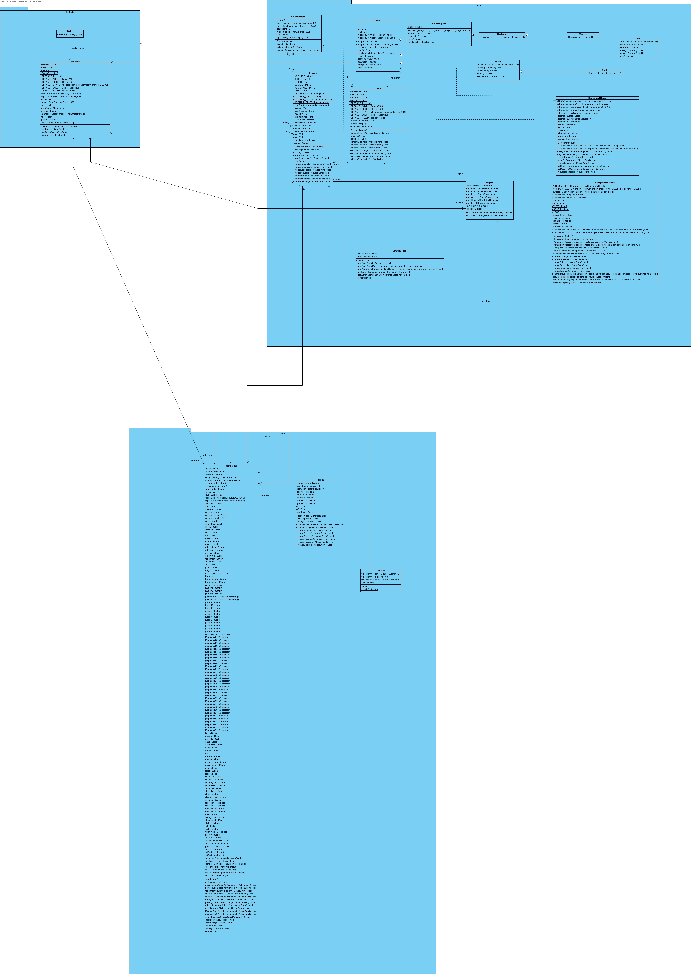
Diagram

